Slide 1
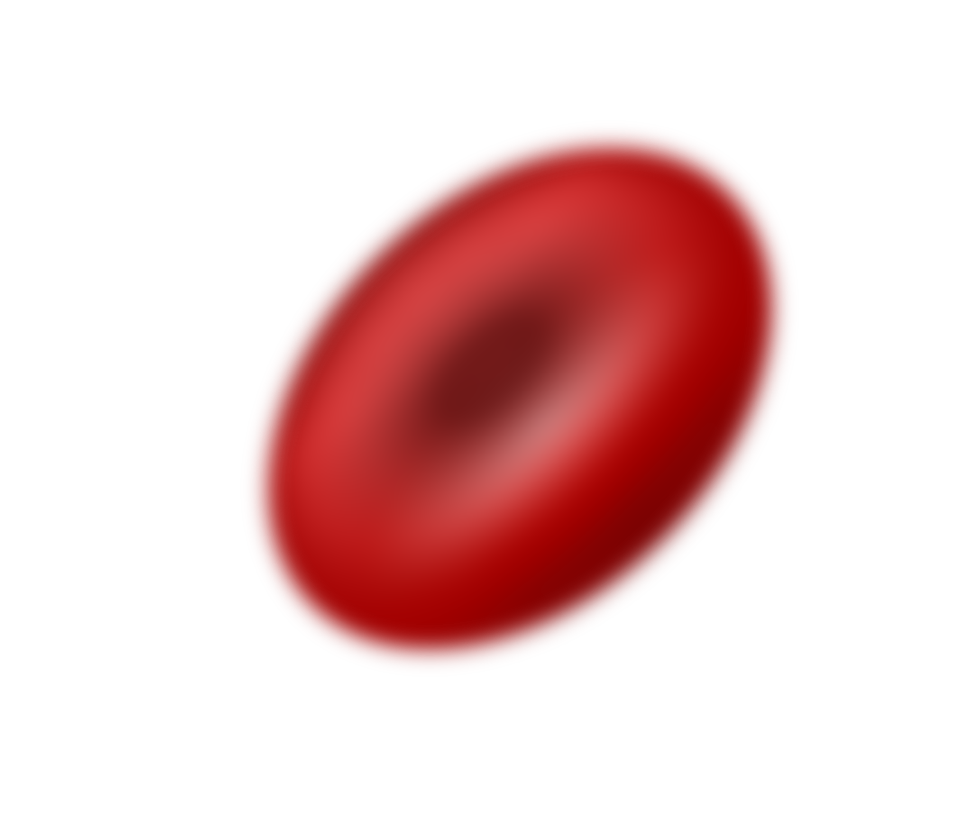
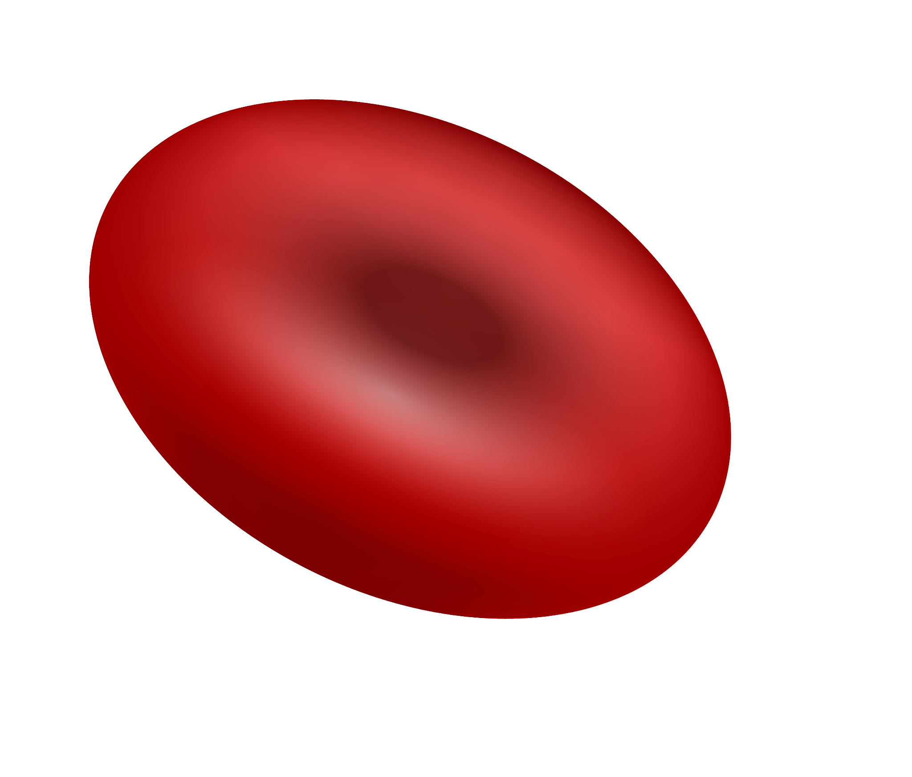
Red Blood Cell Disorders
Here is where your presentation begins

Slide 2
Contents of this template
You can delete this slide when you’re done editing the presentation
Fonts | To view this template correctly in PowerPoint, download and install the fonts we used
Used and alternative resources | An assortment of graphic resources that are suitable for use in this presentation
Thanks slide | You must keep it so that proper credits for our design are given
Colors | All the colors used in this presentation
Icons and infographic resources | These can be used in the template, and their size and color can be edited
Editable presentation theme | You can edit the master slides easily. For more info, click here
For more info: SLIDESGO | BLOG | FAQs
You can visit our sister projects: FREEPIK | FLATICON | STORYSET | WEPIK | VIDEVO

Slide 3
Table of contents
01
02
03
04
05
06
The disease and
its symptoms
People
at risk
Risk
factors
Available treatments
Disease prevention and control
Conclusion

Slide 4
01
The disease and its symptoms

Slide 5
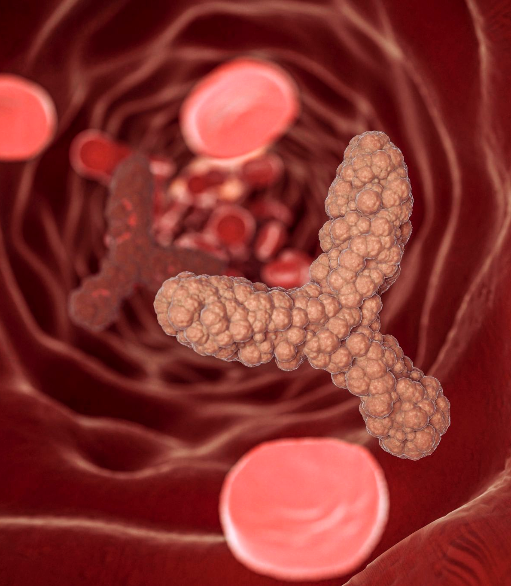
Introduction to the disease
On the first part of the presentation, it’s important to give an overview of the disease you’re going to speak about. This helps your audience easily understand:
The context
The health risks
Likelihood of developing it
Prevalence

Slide 6
Who is at risk?
Genetic
factors
Environmental factors
When a genetic factor puts a person at risk of developing an illness, it means that there is a hereditary component. This can be due to specific genetic mutations or variations that increase a person's susceptibility to developing the illness
When an environmental factor puts a person at risk of developing an illness, it means that exposure to certain substances, conditions, or situations in the environment can increase the likelihood of developing that illness

Slide 7
Three main types of diseases
Infectious
Chronic
Genetic
These are diseases that are caused by pathogenic microorganisms such as bacteria, viruses, fungi, or parasites. Examples of infectious diseases include the flu or tuberculosis
These are long-term illnesses that typically progress slowly and may not have a cure. Chronic diseases can be caused by a variety of factors
These are diseases that are caused by abnormal genes or chromosomal abnormalities. Genetic diseases can be inherited, or they may occur spontaneously

Slide 8
Four main types of treatments
Medical treatment
Behavioral therapy
This involves the use of medications, surgery, radiation therapy, chemotherapy, or other medical procedures to treat a particular illness
Behavioral therapies involve various techniques that are used to treat mental health conditions, such as depression, anxiety, and addiction
Alternative therapies
Lifestyle changes
Alternative therapies include a range of treatments that are not considered part of conventional medical practice
Lifestyle changes involve making modifications to an individual's diet, exercise habits, or other behaviors

Slide 9
Risk factors
Age
Genetics
Lifestyle
Many diseases occur more frequently in certain age brackets
Some diseases have a hereditary component and can be passed down through families
Certain behaviors can increase the risk of developing illnesses
Environment
Medical history
Gender
Exposure to certain substances in the environment can increase the risk of developing some diseases
A personal or family history of certain illnesses can increase the risk of developing
related conditions
Some illnesses are more common in one gender than the other

Slide 10
10,000
85%
1,000
Patients treated
Success rate
Suffered secondary effects

Slide 11
$1 billion
Investment in disease research is crucial for improving public health outcomes, advancing medicine, and improving quality of life for patients, which in turn has the potential for significant economic growth and global health benefits

Slide 12
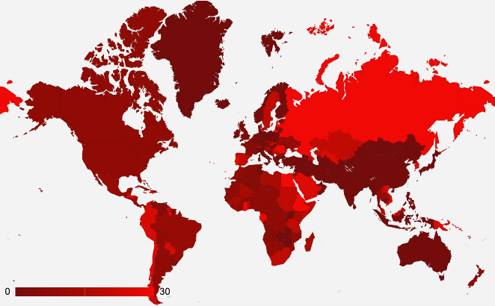
Disease prevalence
0-5% of the population in these regions are affected by the disease
6-14% of the population in these regions are affected by the disease
15-30% of the population in these regions are affected by the disease
Follow the link in the graph to modify its data and then paste the new one here. For more info, click here

Slide 13
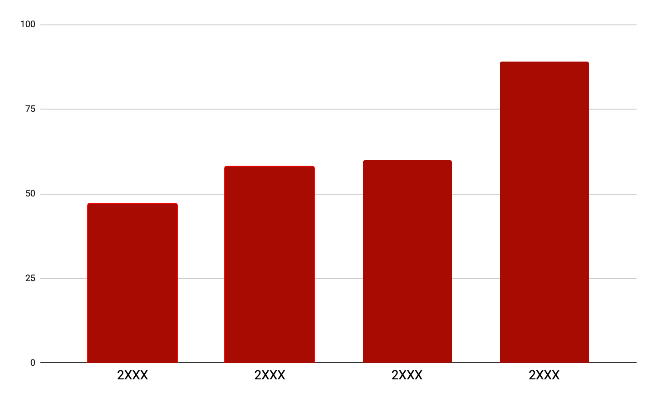
Symptoms and diagnosis
Most common symptoms
Use this slide to display the most common symptoms of the disease being discussed. Include a graph with a clear title and labels for each axis. You can also explain how the disease is diagnosed, including the types of tests or procedures used, to help your audience understand how it is identified and treated
Follow the link in the graph to modify its data and then paste the new one here. For more info, click here

Slide 14
Risk factors and complications
Risk factors | Description | Prevalence | Contributing factors | Complications | Severity
Age over 50 | Being over the age of 50 | 80% of cases | Age-related decline in immune function | Heart attack, Stroke, Kidney damage, Blindness | High
Smoking | Using tobacco products | 30% of cases | Nicotine addiction, Exposure to carcinogens | Lung cancer, Chronic obstructive pulmonary disease (COPD) | Moderate
High blood pressure | Blood pressure consistently above 140/90 mm Hg | 40% of cases | Obesity, Stress, Genetics | Heart disease, Stroke, Kidney damage, Vision loss | High
Family history of disease | Genetic predisposition to the disease | 10% of cases | Family history | Heart disease, Stroke, Kidney damage, Blindness | Moderate

Slide 15
Disease history
Discovery
of the disease
Early research
First treatment
Milestone discoveries
Breakthrough treatment
Epidemic outbreak
Current research
Future directions

Slide 16
Diagnosis and treatment flowchart
Start
Patient symptoms
Diagnostic test
Diagnosis confirmed
Prescribe treatment
List the symptoms that the patient is experiencing:
Write the symptoms of the patient
Write the symptoms of the patient
Write the symptoms of the patient
List the diagnostic tests that were performed:
Write the diagnostic test performed
Write the diagnostic test performed
Write the diagnostic test performed
This step represents the confirmation or ruling out of a specific disease diagnosis based on the results of the
diagnostic tests
List the recommended treatment options
Write the
treatment options
Write the
treatment options
Write the
treatment options
End

Slide 17
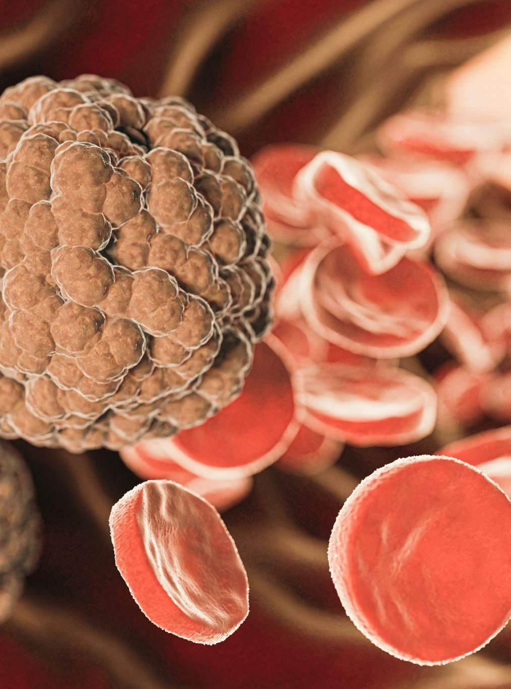
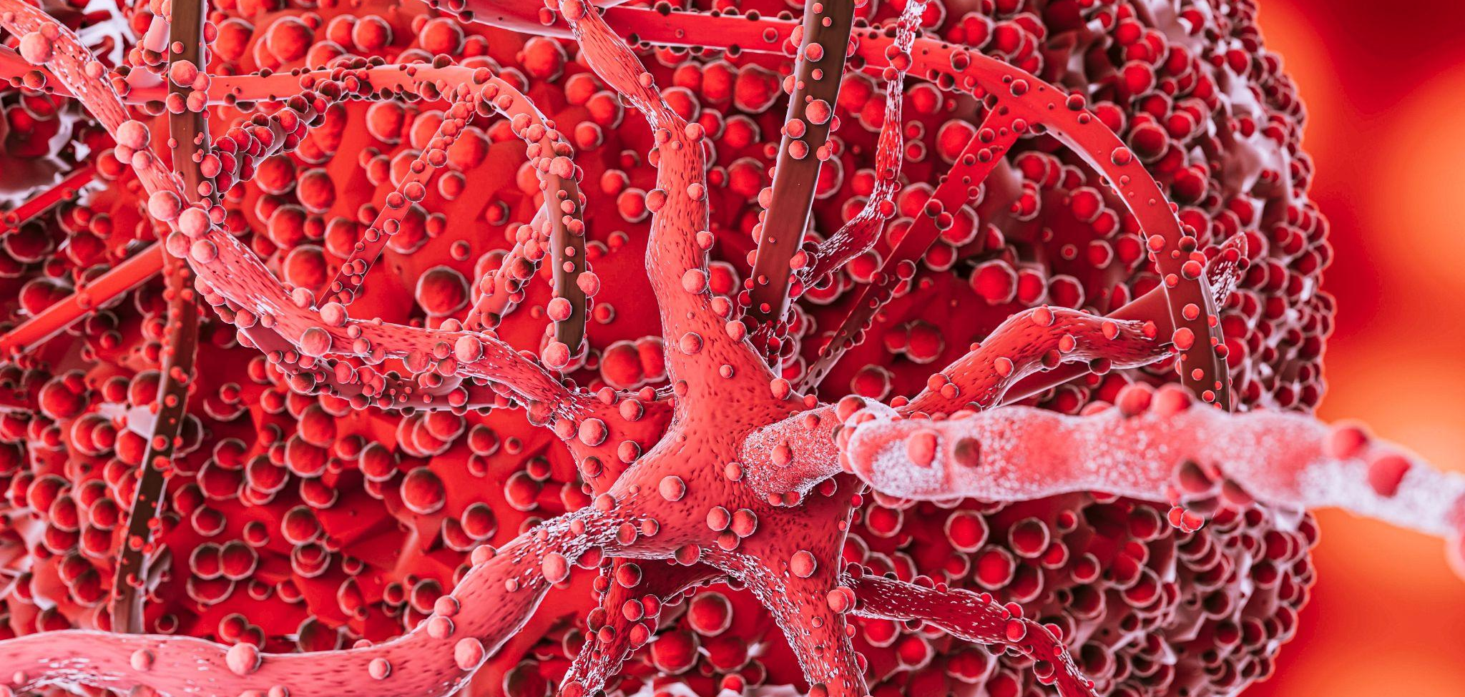
Real life impact
A photo showcase can be a useful addition to a business project proposal as it can help to visually communicate the concept or idea
being proposed

Slide 18
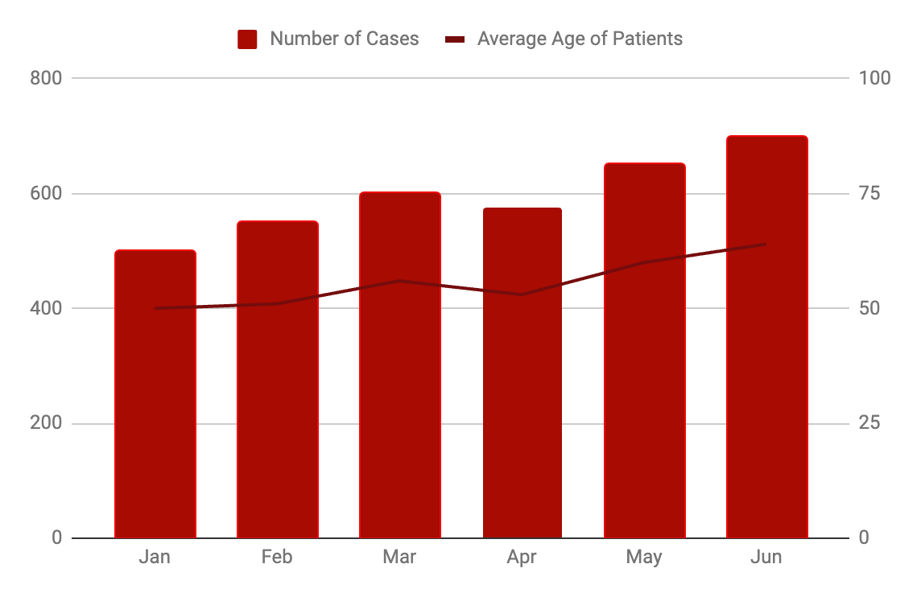
Disease management
Number of cases of the disease over time
Region | Number of cases | Percentage of cases
North | 1,000 | 20%
South | 2,500 | 50%
East | 1,200 | 24%
10%
Decrease in new cases this year
95%
Treatment success rate
20%
Decrease in mortality rate over last year
Follow the link in the graph to modify its data and then paste the new one here. For more info, click here

Slide 19
Disease overview
Information
Causes | Genetic, environmental, and lifestyle factors
Symptoms | Fatigue, weight loss, joint pain, fever, and rash
Diagnosis | Blood tests, imaging tests, and biopsy
Treatment | Medications, surgery, and lifestyle changes
Prevention | Vaccination, hygiene, and avoiding high-risk behaviors
Key findings
Summarize the most important or relevant aspects of the disease
Use bullet points to present the key findings in a clear and organized manner
Conclusions
1
In this section, summarize the key findings from the disease study
2
Provide an overview of the implications for the current diagnosis and treatment plan

Slide 20
Thanks!
Do you have any questions?
youremail@freepik.com
+91 620 421 838
yourcompany.com
Please keep this slide for attribution

Slide 21
Alternative resources
Here’s an assortment of alternative resources whose style fits that of this template:
Vectors
Realistic world blood donor day instagram posts collection
Photos
Representation of microorganisms concept
Representation of microorganisms concept I
Representation of microorganisms concept II

Slide 22
Resources
Did you like the resources on this template? Get them for free at our other websites:
Vectors
Realistic world blood donor day horizontal banners set with red blood cells
Photos
Representation of microorganisms concept
Representation of microorganisms concept I
Representation of microorganisms concept II

Slide 23
Instructions for use
If you have a free account, in order to use this template, you must credit Slidesgo by keeping the Thanks slide. Please refer to the next slide to read the instructions for premium users.
As a Free user, you are allowed to:
Modify this template.
Use it for both personal and commercial projects.
You are not allowed to:
Sublicense, sell or rent any of Slidesgo Content (or a modified version of Slidesgo Content).
Distribute Slidesgo Content unless it has been expressly authorized by Slidesgo.
Include Slidesgo Content in an online or offline database or file.
Offer Slidesgo templates (or modified versions of Slidesgo templates) for download.
Acquire the copyright of Slidesgo Content.
For more information about editing slides, please read our FAQs or visit our blog:
https://slidesgo.com/faqs and https://slidesgo.com/slidesgo-school

Slide 24
Instructions for use (premium users)
As a Premium user, you can use this template without attributing Slidesgo or keeping the "Thanks" slide.
You are allowed to:
Modify this template.
Use it for both personal and commercial purposes.
Hide or delete the “Thanks” slide and the mention to Slidesgo in the credits.
Share this template in an editable format with people who are not part of your team.
You are not allowed to:
Sublicense, sell or rent this Slidesgo Template (or a modified version of this Slidesgo Template).
Distribute this Slidesgo Template (or a modified version of this Slidesgo Template) or include it in a database or in any other product or service that offers downloadable images, icons or presentations that may be subject to distribution or resale.
Use any of the elements that are part of this Slidesgo Template in an isolated and separated way from this Template.
Register any of the elements that are part of this template as a trademark or logo, or register it as a work in an intellectual property registry or similar.
For more information about editing slides, please read our FAQs or visit our blog:
https://slidesgo.com/faqs and https://slidesgo.com/slidesgo-school

Slide 25
Fonts & colors used
This presentation has been made using the following fonts:
Poppins
(https://fonts.google.com/specimen/Poppins)
Comfortaa
(https://fonts.google.com/specimen/Comfortaa)
#f10906
#f3f3f3
#a70b01
#750c0c
#191919

Slide 26





Storyset
Create your Story with our illustrated concepts. Choose the style you like the most, edit its colors, pick the background and layers you want to show and bring them to life with the animator panel! It will boost your presentation. Check out how it works.
Pana
Amico
Bro
Rafiki
Cuate

Slide 27
Use our editable graphic resources...
You can easily resize these resources without losing quality. To change the color, just ungroup the resource and click on the object you want to change. Then, click on the paint bucket and select the color you want. Group the resource again when you’re done. You can also look for more infographics on Slidesgo.

Slide 30
JANUARY
FEBRUARY
MARCH
APRIL
MAY
JUNE
PHASE 1
Task 1
Task 2
PHASE 2
Task 1
Task 2
JANUARY
FEBRUARY
MARCH
APRIL
PHASE 1
Task 1
Task 2

Slide 33
...and our sets of editable icons
You can resize these icons without losing quality.
You can change the stroke and fill color; just select the icon and click on the paint bucket/pen.
In Google Slides, you can also use Flaticon’s extension, allowing you to customize and add even more icons.

Slide 34
Educational Icons
Medical Icons

Slide 37
Creative Process Icons
Performing Arts Icons

Slide 38
Nature Icons

Slide 39
SEO & Marketing Icons

Slide 40


